Slide 1
FACE IDENTIFICATION

Slide 2
Topics of the Seminar
System Design
(a) Detailed Design
i. U.M.L Diagram
(b) Database Design
i. Dataflow Diagram
ii. Database Dictionary
iii. E-R Diagrams
2. Screens
3.Testing & Types of Testing
4.Implementation
5. Conclusion

Slide 3
U.M.L DIAGRAMS
U.M.L Diagrams stands for unified modeling language. It is the international Standard notation for object oriented analysis and design.
DIAGRAMS IN U.M.L:
Class Diagram
Object Diagram
Use Case Diagram
Sequence Diagram
Collaboration Diagram
State Chart Diagram
Activity Diagram

Slide 4
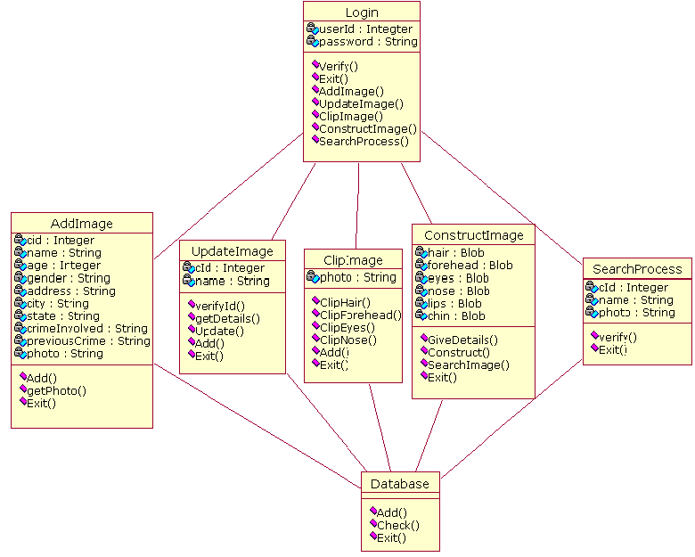
CLASS DIAGRAM

Slide 5
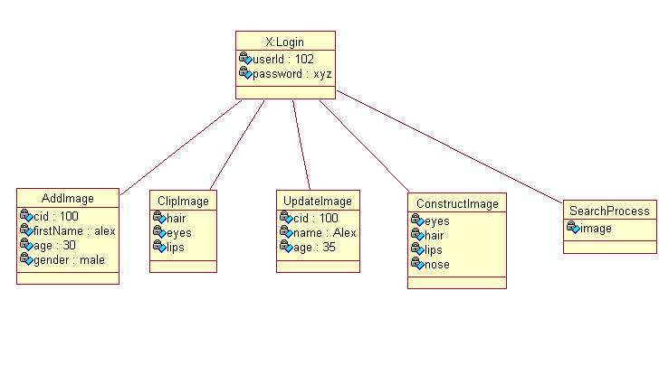
OBJECT DIAGRAM

Slide 6
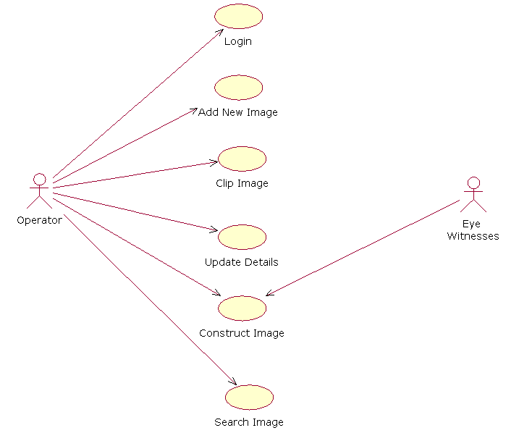
USE CASE DIAGRAM

Slide 7
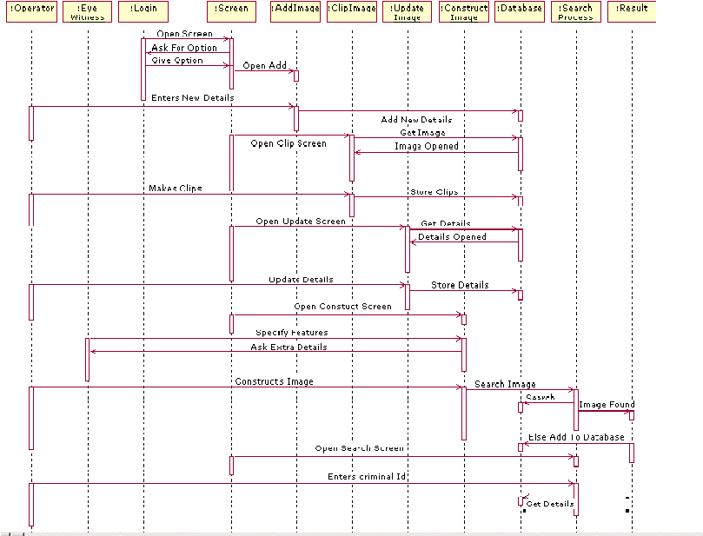
SEQUENCE DIAGRAM

Slide 8
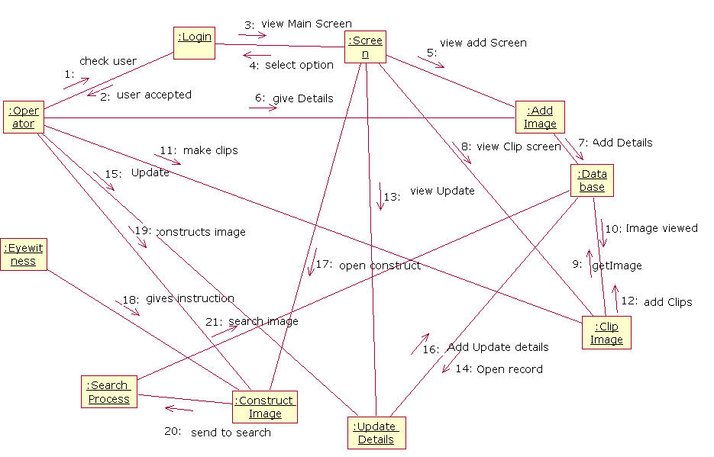
COLLOBORATION DIAGRAM

Slide 9
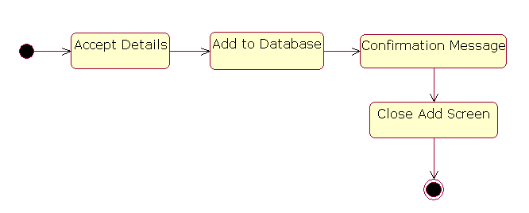
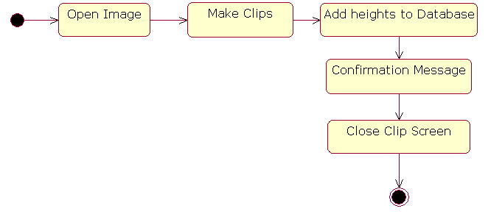
STATE CHART DIAGRAM
ADD MODULE
CLIP IMAGE MODULE

Slide 10
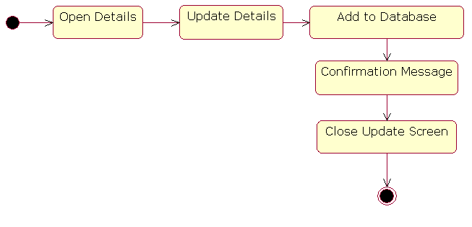
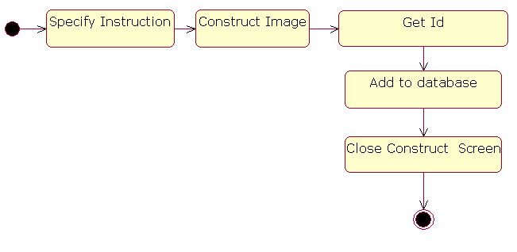
UPDATE DETAILS:
CONSTRUCT MODULE:

Slide 11
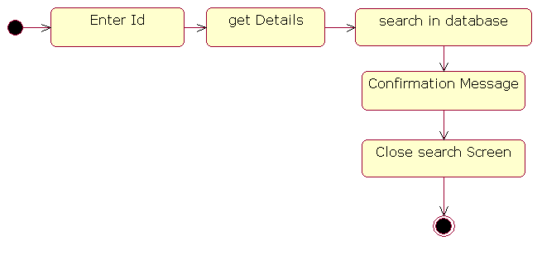
SHOW DETAILS:

Slide 12

ACTIVITY DIAGRAM
Login
Authentication
Valid User
Invalid User
Main Screen
Add Image
Clip Image
Update Details
Construct Image
Search Process
Enter Details
Open Image& Make Clips
Open Record & Update
Specify Feature
Search Image & Get Details
Add to Database
Add Clips to Database
Add to database
Search Image
Result
End

Slide 13
DATA FLOW DIAGRAMS
Data Flow Diagrams are the central tool and the basis from which other components are developed.
BASIC NOTATION:
DATA FLOW:
2. PROCESS:
3. SOURCE:
4. DATA STORE:

Slide 14
PROCESS FLOW DIAGRAM
Start
Login
Authentication
Valid User
Invalid User
Main Screen
Add Image
Clip Image
Update Details
Construct Image
Search Process
Enter Details
Open Image& Make Clips
Open Record & Update
Specify Feature
Search Image & Get Details
Add to Database
Add Clips to Database
Add to database
Search Image
Result
End

Slide 15
CONTEXT FLOW DIAGRAM
EYE WITNESS
FACE IDENTIFICATION SYSTEM
OPERATOR
CRIMINAL FACE

Slide 16
LOGIN PROCESS
PROCESS
LOGIN
SCREEN
ERROR IN
INPUT
LEVEL-0
MAIN SCREEN PROCESS
MAIN SCREEN
OPERATOR
ADD IMAGE
SEARCH IMAGE
CLIP IMAGE
CONSTRUCT IMAGE
LEVEL-1

Slide 17
ADD IMAGE PROCESS
DATABASE
ADD PROCESS
OPERATOR
DATA IS ADDED
CLIPPING PROCESS
ERROR
LEVEL-2
DATABASE
DATABASE
EYES
NOSE
FACE
FACE
HAIR
FOREHEAD
LEVEL-3

Slide 18
UPDATE PROCESS
DATABASE
UPDATE PROCESS
OPERATOR
DATA UPDATED
LEVEL-4
CONSTRUCT IMAGE
DATABASE
HAIR
FOREHEAD
INSTRUCTION
EYES
FACE
NOSE
LIPS
LEVEL-5

Slide 20
E-R DIAGRAM
Entity Relationship model is a tool that is commonly used to translate different views of data among managers, users and programmers to fit into a common framework.
Basic Notations:
Entity:
Attributes:
Relationships:

Slide 21
Cid
fnamee
Forehead
Hairs
Nose
age
Crime Involved
Chin
Connected by
FACE
Face_heights
Crime Id
Suspect Photo
Crime Id
Cid
Photo Height
Connected by
Face_Suspect photo
Face_Suspects

Slide 22
DATABASE TABLES
FACE
Field Name | Data Type | Size
Criminal Id First Name Last Name Alias Name D.O.B Age Gender Address City State Arrested Date Crime Involved In Photo | Number Varchar2 Varchar2 Varchar2 Date Number Varchar2 Varchar2 Varchar2 Varchar2 Date Varchar2 Varchar2 | 5 (Primary Key) 15 15 15 5 15 15 15 15 15 15
CRIMINAL_SUSPECT TABLE
Field Name | Data Type | Size
Criminal Id Cid | Number Number | 5 (Primary Key) 5

Slide 23
FACE_HEIGHTS TABLE
Field Name | Data Type | Size
Criminal Id Hair Forehead Eyes Nose Lips Chin | Number Number Number Number Number Number Number | 5 5 5 5 5 5 5
FACE_SUSPECTPHOTO
Field Name | Data Type | Size
Cid Suspect Photo Suspect Height | Number Varchar2 Varchar2 | 5 15 15

Slide 24
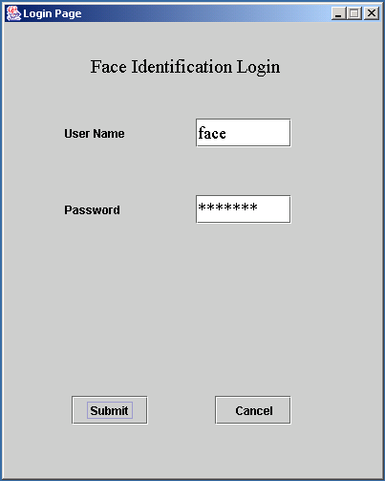

Slide 25
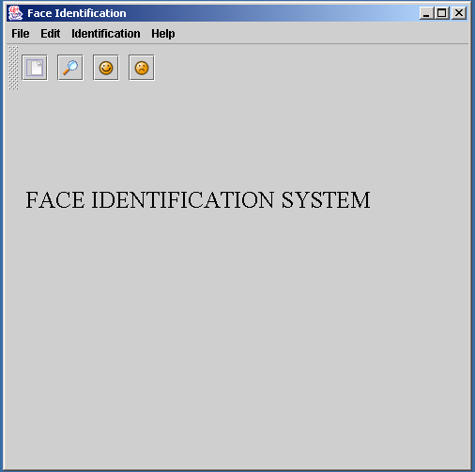

Slide 26
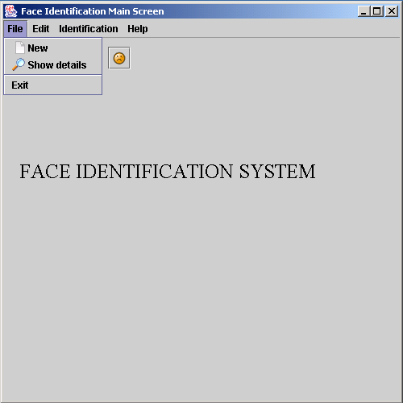

Slide 27
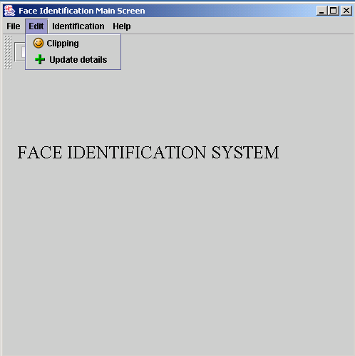

Slide 28
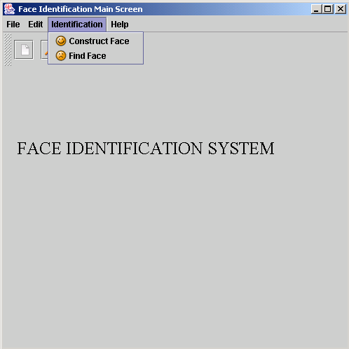

Slide 29
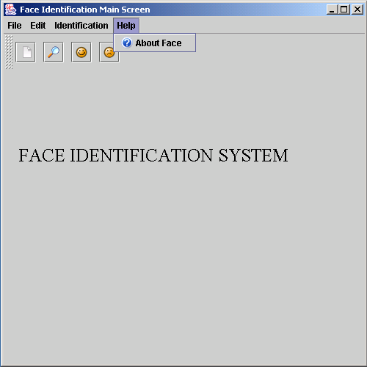

Slide 30
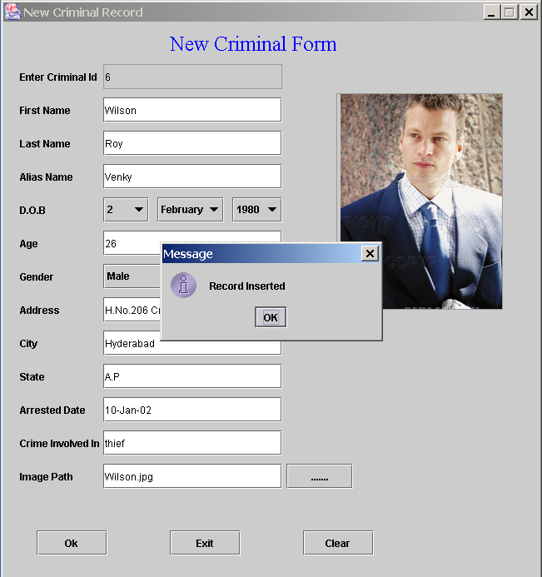

Slide 31
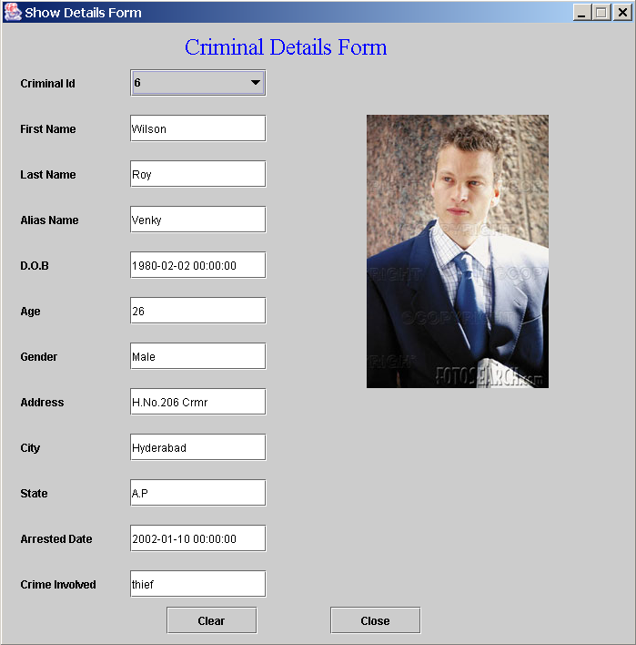

Slide 32
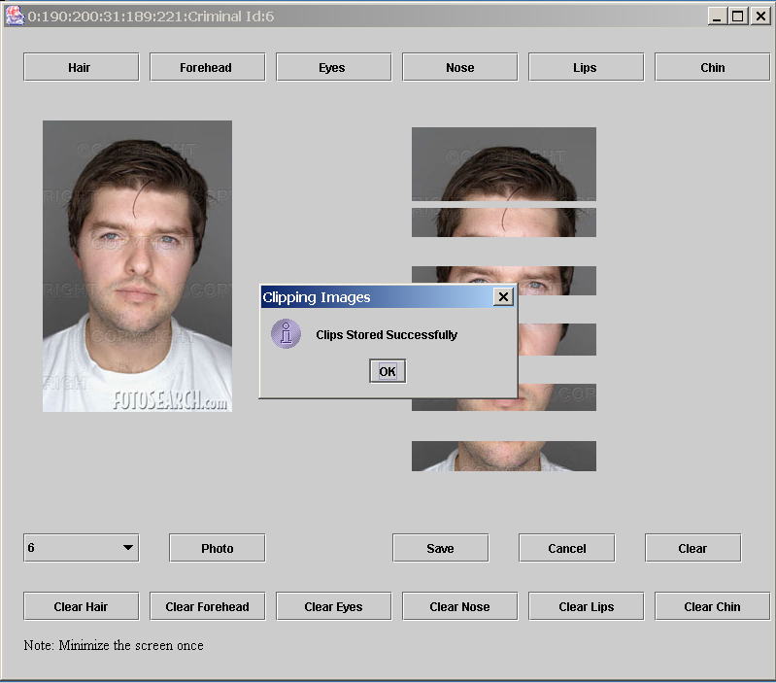

Slide 33
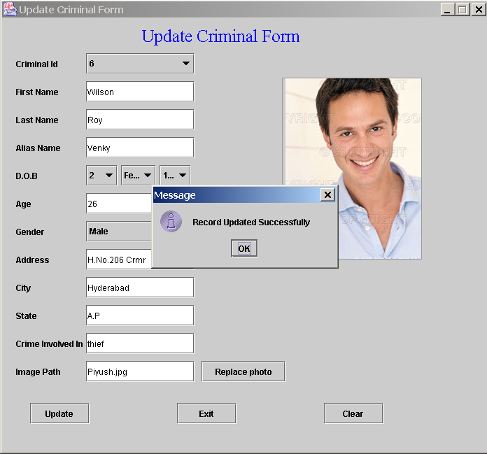

Slide 34
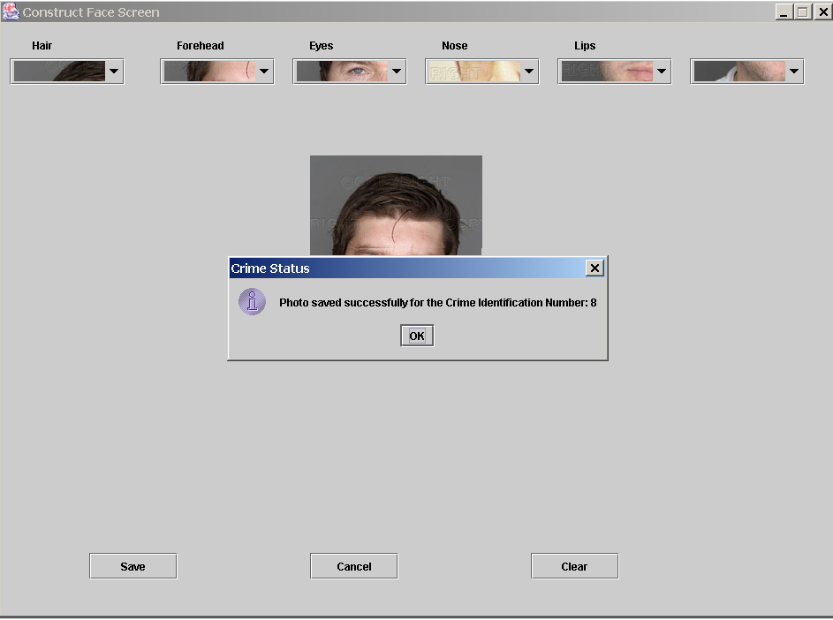

Slide 35
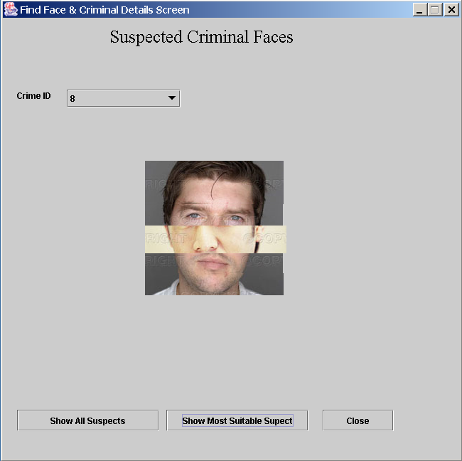

Slide 36
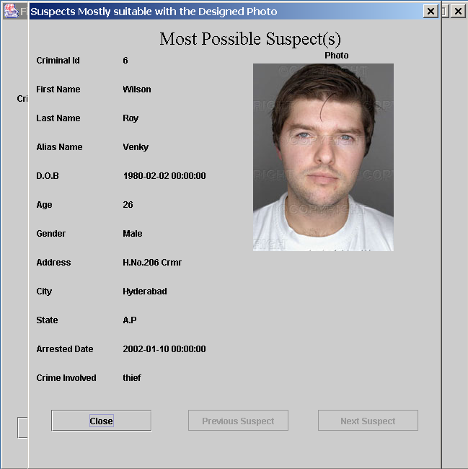

Slide 37
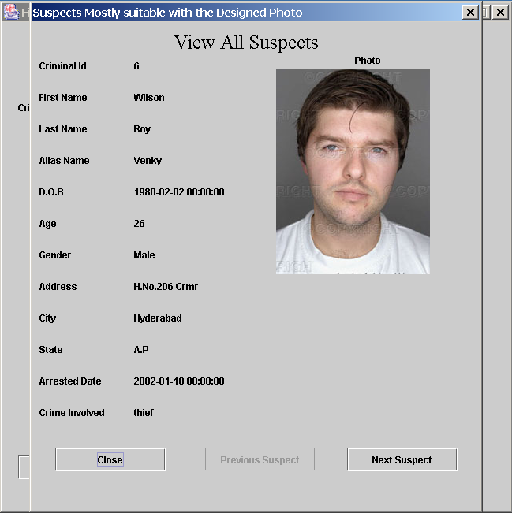

Slide 38
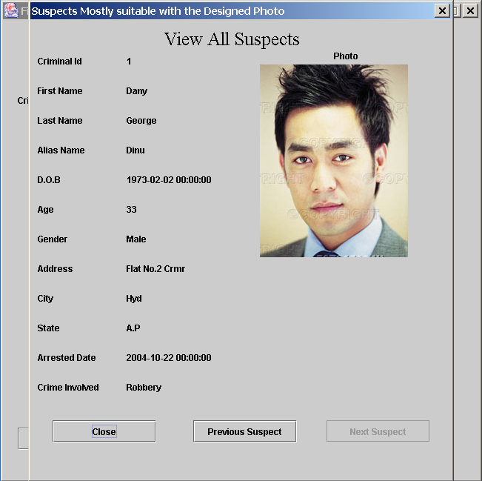

Slide 39
